Slide 1
The Battle of the Neighbourhoods (Singapore)

Slide 2
Project Scope
The goal is to build a recommendation system to help traveller/resident decide on which neighbourhood to visit among the available popular locations in Singapore.

Slide 3
Targeted Audience:
The targeted audience is individuals who have very less information about Singapore.
The individual could be a traveller visiting Singapore for the very 1st time or a resident who wants to explore and compare different places in and around Singapore.
Customer Requirements:
My Customer would like to visit a location in Day Time under Clear Weather Conditions
My Customer would like to have options of dining, Shopping and Movies
My Customer would like to have an option to select from multiple cuisine
My Customer would like to be recommended on the Top Restaurants and its Operational Status Real-Time.

Slide 4
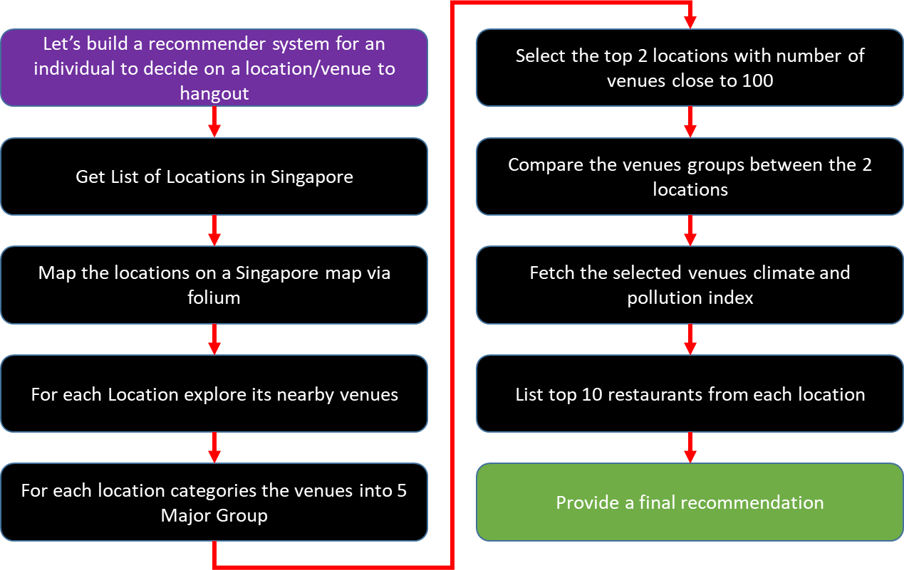
Flow Chart

Slide 5
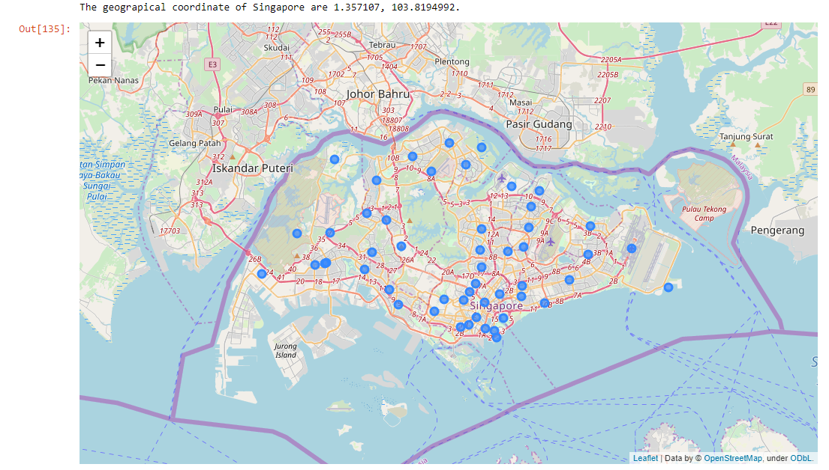
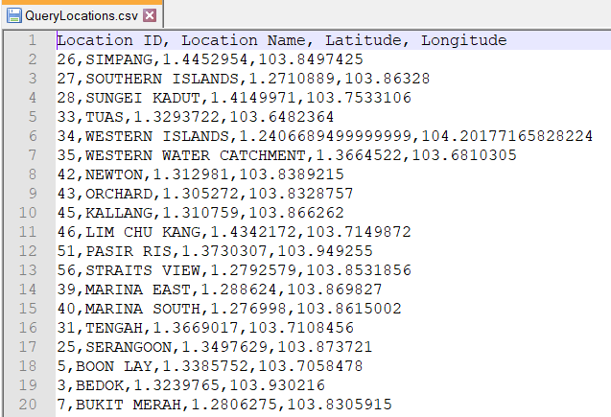
Locations in Singapore
Follium
https://docs.onemap.sg/

Slide 6
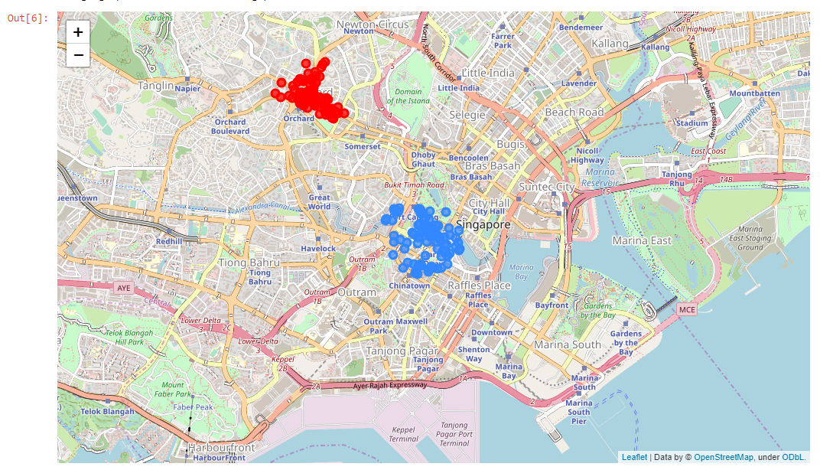
Two Prime Locations Selected
* Greater than 100 Venues
https://api.foursquare.com/v2/venues/explore

Slide 7
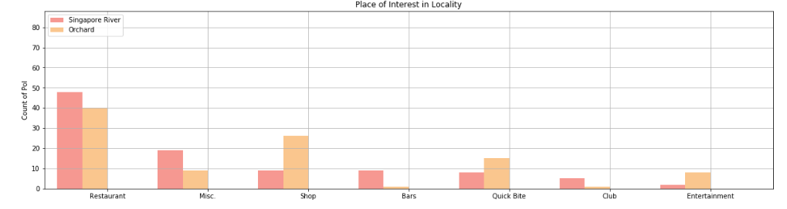
Categorizing & Comparing the venues in Prime Locations
ORCHARD – Good for Day Exploration with Food, Shops and Entertainment
Singapore Rvier – Good for Night Exploration with Pubs, Bars and Food

Slide 8
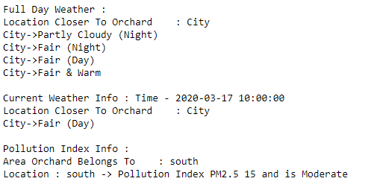
Our Customer Selects Orchard
It’s a Good Day to Explore

Slide 9
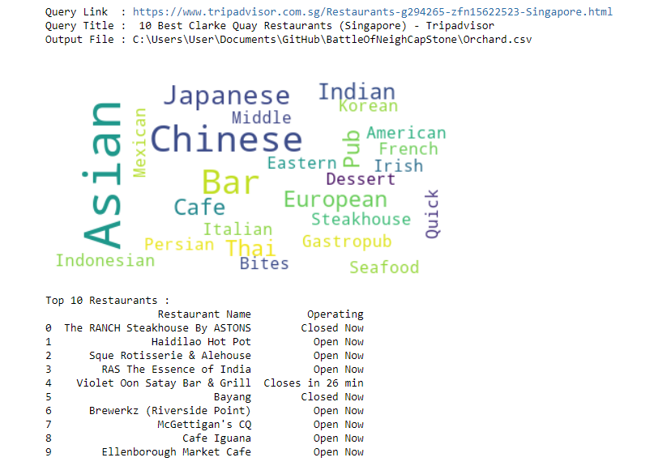
Restaurant Recommendation

Slide 10
Results
We found the list of locations in Singapore using the OneMapSG API results
Using the Foursquare API we explored the available venues in each locations and selected the Top 2 venues with number of venues equal to 100
The venues were further categorized and compared across both the locations to select the best location for our customer to visit
Once our customer has decided the locations we provided him the real-time weather conditions, as Singapore’s climate at times become unpredictable. Singapore Governments database was used to retrieve this information real-time.
Assume our customer is planning on visiting a restaurant we use the trip advisor page to retrieve the top 10 restaurants and popular cuisine information at his selected location
Also, we provided him the real time operational status of the restaurants
Thus a basic recommendation system was built using the available web data to recommend a suitable location to explore and then dine at a restaurant of the customer choice, satisfying his requirements.

Slide 11
Conclusion
This analysis is performed on limited data and few assumptions were made to arrive at the final recommendation. This can be further expanded in to a real – time interactive application with more granular representation of the data and recommendations.
Thank You !!!

